Slide 1
Challenge L2 — Supply Chain Disruption Assistant & Fleet Utilisation Optimizer
SentinelChain
An agent that turns four disconnected feeds into one ranked decision queue — and catches the cold-chain breach while the truck is still moving.
$9.99M
140
10 of 10
+28.1 pts
value defended per run
shipments monitored
cold breaches caught in transit
fleet utilisation
Notes:
Opening. 15 seconds: name, what it does, the number. SentinelChain turns four disconnected feeds into one ranked decision queue. On the seeded demo dataset it defends ten million dollars of cargo value in a single run.

Slide 2
01 / the problem
One event, hundreds of consequences, zero visibility
Everything below is happening at the same time, in four systems that do not talk to each other.
The cascade is invisible
A Suez advisory is one headline. Underneath it sit 65 shipments, 21 of them temperature-controlled, spread across four carriers. Nobody can hand-trace that before the boxes move.
The fleet is idle in the wrong place
37 assets sat past their idle threshold while other lanes ran short. The carrying cost was already spent — $89,931 of it — before anyone looked.
The cold breach is found too late
A single excursion can spoil a $500K+ cargo. Today it surfaces at the delivery door, after the intervention window has closed and the batch record is already wrong.
Notes:
The pain, in three sentences. Do not read the slide — say: a disruption is one event but hundreds of consequences; the fleet that could absorb it is sitting idle somewhere else; and the cold chain failure is discovered at the delivery door, which is the one moment you can do nothing about it.

Slide 3
02 / how it works
One agent, four deterministic engines
The agent decides which tool to call. The engines decide the numbers. Nothing in between.
Agent layer — intent routing, guardrails, approval thresholds, narration
6 registered tools · JSON-schema specs · platform-agnostic adapter
Exposure
Re-route
Fleet
Cold chain
Matches live disruptions to every shipment that still has to transit an affected node. Ranks by value, SLA headroom, fragility, severity, time-to-choke.
Generates hold / bypass / mode-shift options and scores each on expected total cost. Doing nothing always competes.
Flags assets idle past a kind-specific threshold and matches them to demand the re-route engine just created.
Computes MKT and time-out-of-range from IoT logs, consumes the product stability budget, assigns a regulatory severity band.
Every figure the agent speaks is a value an engine returned. The agent is replaceable; the arithmetic is not.
Notes:
How it works, one screen. The agent never does arithmetic. It picks a tool. The four engines are deterministic Python — same inputs, same numbers, every time. That is what makes the output defensible to a regulator.

Slide 4
03 / exposure engine
Which shipments does this disruption actually touch?
A shipment is exposed if any node it has not yet cleared is affected. Then it has to be ranked, or the list is noise.
Exposure score
109 / 140
$48.91M
Value at risk
30%
shipments exposed
value at risk
Cargo fragility
22%
SLA breach depth
20%
Worst incident right now
Red Sea transit advisory — Suez routings diverting via Cape of Good Hope
Disruption severity
16%
Time-to-choke × priority
12%
65 shipments · $27.57M at risk · 21 cold-chain · 65 SLA breaches
Fragility is class-specific: a vaccine scores 1.00, an automotive casting 0.20.
Notes:
Engine one. The scoring formula is on the slide because judges will ask how we rank. Point out that 109 of 140 shipments are exposed — a raw list is useless, which is exactly why the score exists.

Slide 5
04 / re-route engine
Every option competes against doing nothing
Expected total cost = SLA penalty + spoilage risk + incremental freight. Lowest wins.
The constraint that keeps it honest
Air freight capacity is finite. We allocate it to the shipments where it buys the most, and 10 shipments fell back to a surface option after it ran out.
Worked example — SHP-80050
Shift to Qatar Air Cargo (air)
Costs $13,167 more in freight. Saves $578,196 against holding. Confidence 93%.
Total saved across the decision queue: $3,416,883
Notes:
Engine two, and the slide judges remember. Two points: doing nothing is scored as an option, so the model has to beat it; and air capacity is finite, so ten shipments got a cheaper-on-paper air option taken away from them. That constraint is what stops the demo from just flying everything.

Slide 6
05 / fleet engine
Idle assets are not a separate problem
The re-route engine creates the demand. The fleet engine fills it with metal that was already paid for.
37
$89,931
27
$401,276
assets idle past threshold
carrying cost already burned
redeployed this cycle
net value recovered
How a match is made
A reroute raises a demand signal: reefer box, this node, within 72h
Candidates filtered on reefer capability, capacity and a 4,500km radius
Ranked on value released minus repositioning cost
Assets already at the node move for nothing and win outright
Notes:
Engine three. The key insight: idle assets are not a separate problem. The re-route engine creates the demand — a box diverted via Durban needs a reefer at Durban — and the fleet engine fills it. That link is why the two features belong in one product.

Slide 7
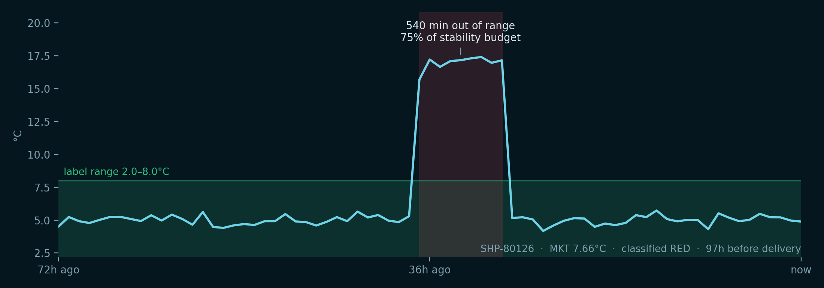
06 / cold chain engine
Not an alarm. A classification a regulator would accept.
Mean Kinetic Temperature plus cumulative time-out-of-range, consumed against the product's own stability budget.
RED
5
Do not distribute. Recall workflow.
ORANGE
5
Quarantine. Stability assessment.
AMBER
1
Release with deviation note.
GREEN
30
Auto-release to batch record.
Why MKT and not a threshold alarm
10 of 10 flagged shipments were caught while still in transit — $6.17M of cargo with the intervention window still open.
A threshold alarm fires the same way for a 20-minute door-open blip and a 9-hour reefer failure, so operators learn to ignore it. MKT is the single isothermal temperature that would degrade the product as much as the real profile did — it separates the two, and it is the number a regulator asks for.
Notes:
Engine four. This is the differentiator. Say it plainly: a threshold alarm treats a twenty-minute door-open blip and a nine-hour reefer failure the same way, so operators learn to ignore alarms. Mean Kinetic Temperature is what a regulator actually asks for, and it is why our severity bands hold up.

Slide 8
07 / the product
One screen, four answers, no dashboards to stitch
Ask in plain language. The agent picks the tool and quotes what the engine returned.
“Which vaccine shipments have a temperature problem?”
agent → analyse_cold_chain()
Returns RED and ORANGE shipments with MKT, budget consumed, hours to delivery and the required disposition.
“What should I do about the Suez diversion?”
agent → assess_disruption_impact()
Returns the exposed shipments ranked, with the node that blocks each one and how many days until it gets there.
“Any idle containers I can redeploy?”
agent → propose_redeployment()
Returns matched assets with distance, cost to move, idle days ended and net benefit.
Live demo: sentinelchain_dashboard.html — single file, opens offline, no server, no keys.
Notes:
Show, don't tell. Open the dashboard here and run one query live. Suggested: 'which vaccine shipments have a temperature problem?' — it routes to analyse_cold_chain and returns the RED shipments with hours remaining.

Slide 9
08 / trust
The agent proposes. It never moves freight.
Guardrails live in code, not in the prompt — a prompt can be talked out of a rule.
No arithmetic in the model
Approval thresholds are hard-coded
Every number comes from a deterministic engine. Same inputs, same output, every run — which is what an audit needs.
Anything above $25,000 incremental spend, anything touching a vaccine or frozen biologic, and every RED disposition is a proposal that waits for a human.
Every recommendation carries its numbers
Write access is a proposal queue
Dollar delta versus doing nothing, the assumption that drove it, and a confidence. No unexplained ranking.
The agent can read every system and change none of them. Notices are drafted, never sent.
11 of 25 recommendations in this run were held for human sign-off.
Notes:
Trust. Judges will probe whether an LLM is inventing numbers. The answer is that it cannot: it has read access to tools and write access to nothing except a proposal queue, and the arithmetic lives in tested Python.

Slide 10
09 / integration
Built to drop onto Bob, or anything else
Six tools, written as standard JSON-schema function specs, behind one swappable adapter.
Registered tools
The seam
assess_disruption_impact()
PlatformAdapter needs one method: call_model(system, messages, tools). Implement it against Bob's runtime and the engines, guardrails and dashboard are unchanged. A deterministic offline router ships alongside it so the demo runs with no network.
Ranks every shipment still facing an affected node.
recommend_reroute()
Scores hold, bypass and mode-shift on expected total cost.
find_idle_assets()
Lists assets idle past threshold, with carrying cost.
Real data, day one
propose_redeployment()
Shipments and lanes: TMS export or EDI 214 / IFTSTA
Disruptions: carrier advisories, port bulletins, weather APIs
Fleet: telematics feed, keyed on asset ID
Cold chain: reefer IoT loggers over MQTT
Matches idle metal to the demand a reroute just created.
analyse_cold_chain()
Computes MKT, time-out-of-range and severity band.
draft_stakeholder_notice()
Drafts the customer, QA or carrier notice. Never sends.
Notes:
Integration. Say: the tool registry is written as JSON-schema function specs, so it drops onto Bob or any tool-calling runtime through one adapter. Nothing else in the codebase changes. The offline router exists so the demo runs with no network in this room.

Slide 11
10 / what is real
What is real, and what is not
The dataset is synthetic and seeded. Everything computed on top of it is production logic.
Real
Not yet
All four engines, end to end, in tested Python
MKT computed to the ICH convention, not approximated
Severity rules mapped to named regulatory clauses
Cost model with a real trade-off, including a capacity constraint
Agent tool registry, guardrails and approval thresholds
Single-file dashboard that runs with no server
Live carrier and telematics connectors — dataset is seeded synthetic
Carrier space is assumed available at the quoted index, not booked
Stability budgets are per class, not per product SKU
Fleet matching is greedy, not a solved optimum
No write-back to TMS; proposals stop at the queue
Everything in the left column runs in front of you. Nothing in this deck is a mock-up.
Notes:
Honesty slide. Judges trust a team that says what is not real. Be quick and matter-of-fact, then move to the close.

Slide 12
11 / the result
One run. One operator. Four decisions that used to take a day.
$9.99M
Re-routing decisions
$3.42M
Cold chain caught in transit
$6.17M
of cargo value defended in a single control-tower run
Fleet redeployment
$401k
SentinelChain · Challenge L2 · run python run_demo.py, then open out/sentinelchain_dashboard.html
Notes:
Close on the number, then stop talking. The one-line version: we find the shipments that matter, we price the alternatives, we put the idle metal back to work, and we catch the cold-chain breach while there is still something to do about it.

